Slide 1
SetId 1
Table 1 (p,q,r,s,n,m,ψ(n), ʎ(n))
Table 2 (g,e,d, µ)

Slide 2
SetId 2
SetId 2
Table 1 (p,q,r,s,n,m,ψ(n), ʎ(n))
Table 1 (p,q,r,s,n,m,ψ(n), ʎ(n))
Table 2 (g,e,d, µ)
Table 2 (g,e,d, µ)
SetId 2
SetId 2
Table 1 (p,q,r,s,n,m,ψ(n), ʎ(n))
Table 1 (p,q,r,s,n,m,ψ(n), ʎ(n))
Table 2 (g,e,d, µ)
Table 2 (g,e,d, µ)

Slide 3
SetId 4
Table 1 (p,q,r,s,n,m,ψ(n), ʎ(n))
Table 2 (g,e,d, µ)

Slide 4
SetId 3
Table 1 (p,q,r,s,n,m,ψ(n), ʎ(n))
Table 2 (g,e,d, µ)

Slide 5
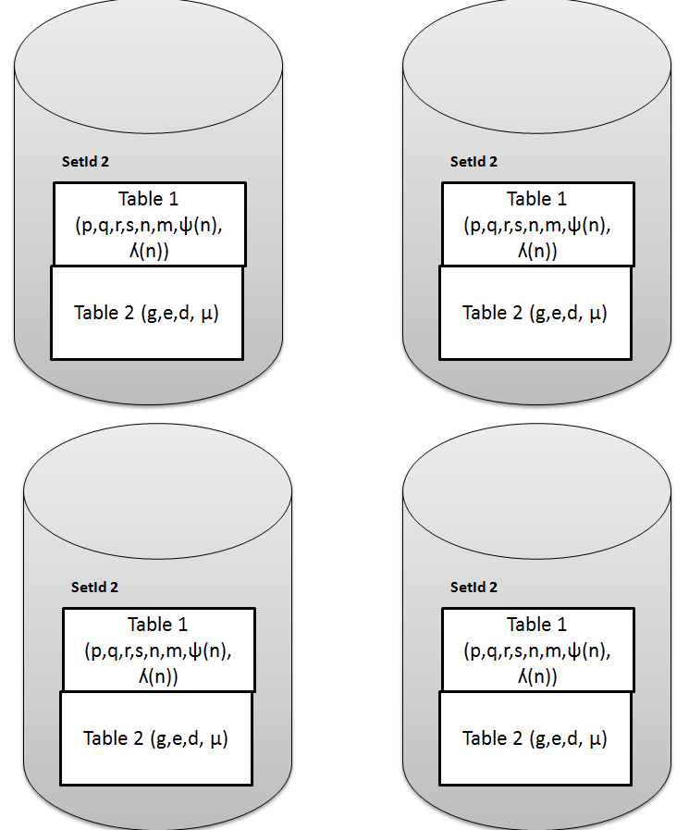
Site A
Level 1& 2
Select Security level
Level 3 & 4
Decryption
operation
Encryption
Cipher Text
BigInteger Library
Plain Text
BigInteger Library
Stop
Process
Process
Decryption
Encryption
Plain Text
Cipher Text
Indexes Exchange
Chang Level
Continue
Stop
Send the indices(Key)
Send the indices
Ack wait for response send and Finnish
Ack wait for response send and Finnish

Slide 6
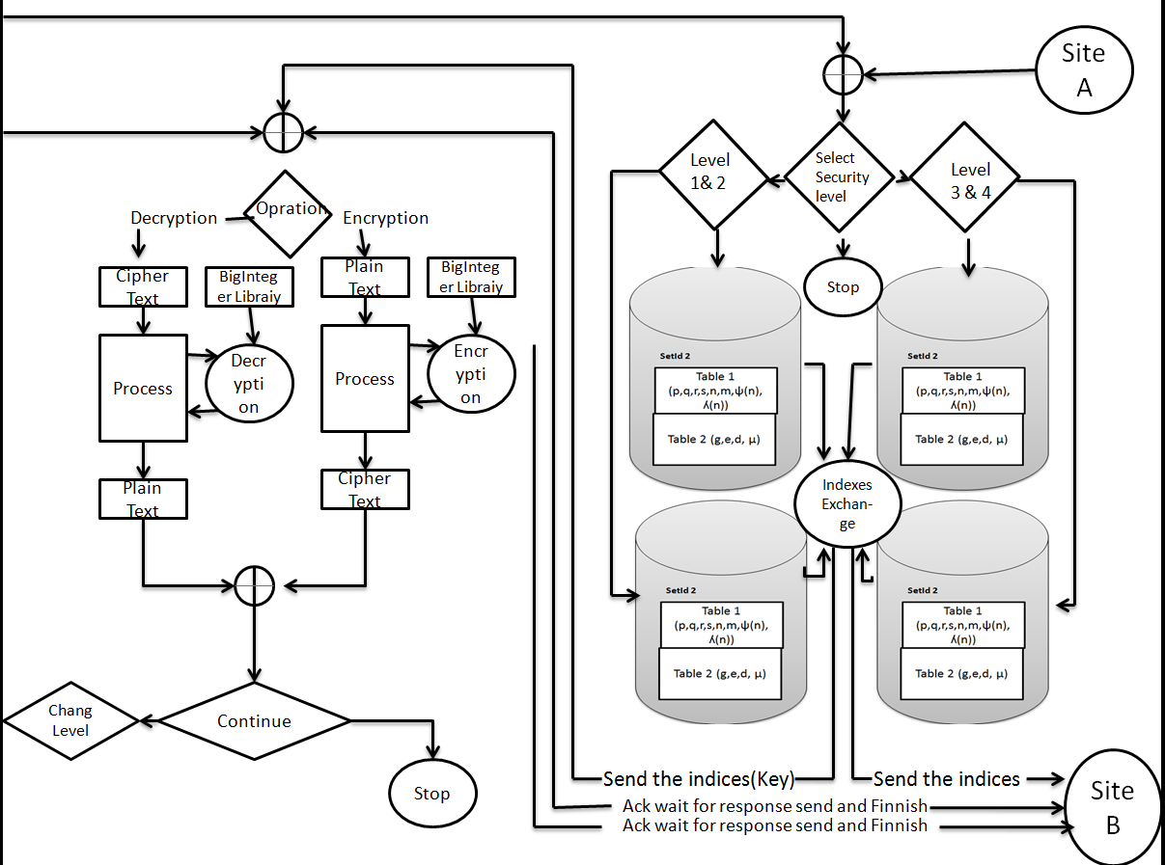

Slide 7
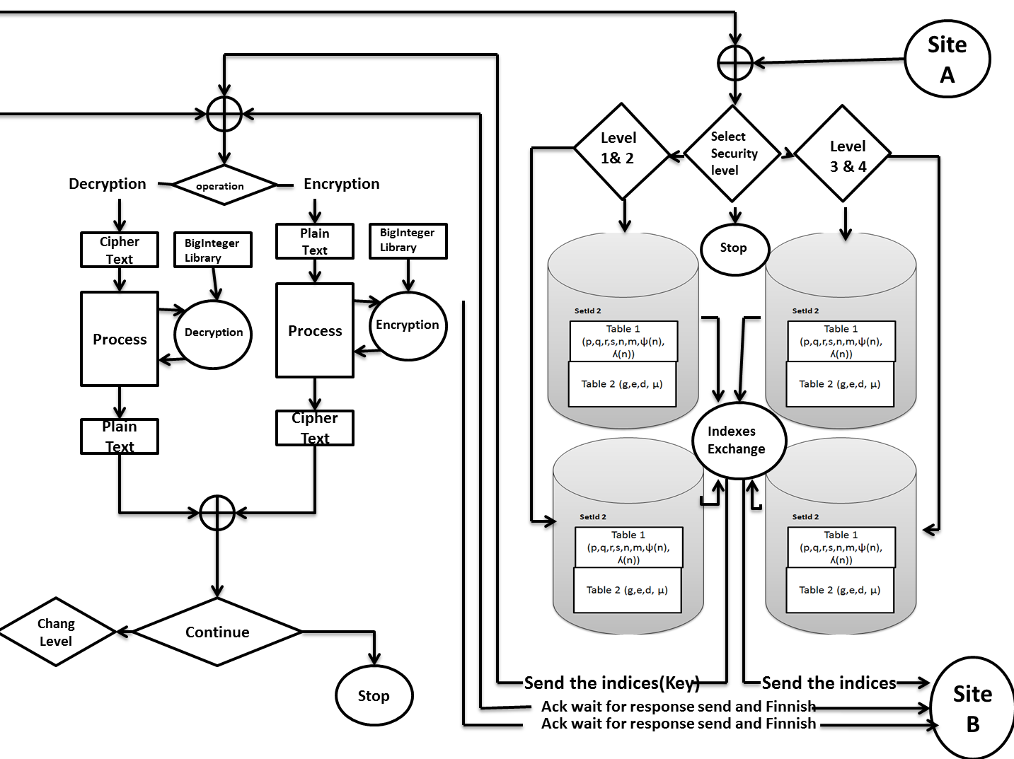

Slide 8
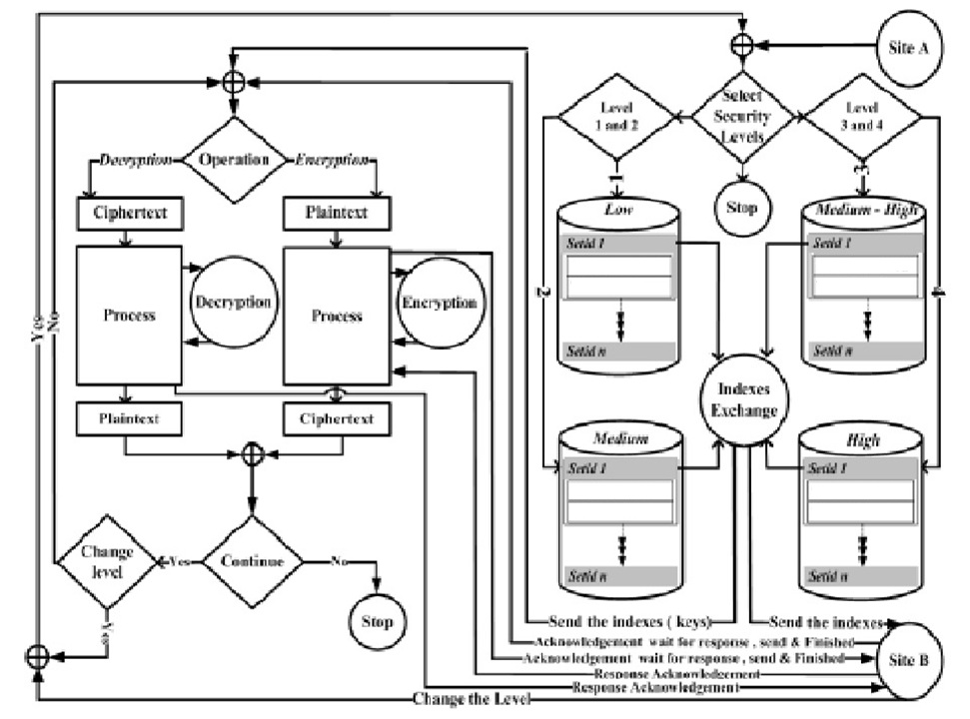
BigInteger library
BigInteger library
Table 1 (p,q,r,s,n,m,
ψ(n), ʎ(n))
Table 1 (p,q,r,s,n,m,
ψ(n), ʎ(n))
Table 2 (g,e,d, µ)
Table 2 (g,e,d, µ)
Table 1 (p,q,r,s,n,m,
ψ(n), ʎ(n))
Table 1 (p,q,r,s,n,m,
ψ(n), ʎ(n))
Table 2 (g,e,d, µ)
Table 2 (g,e,d, µ)

Slide 9
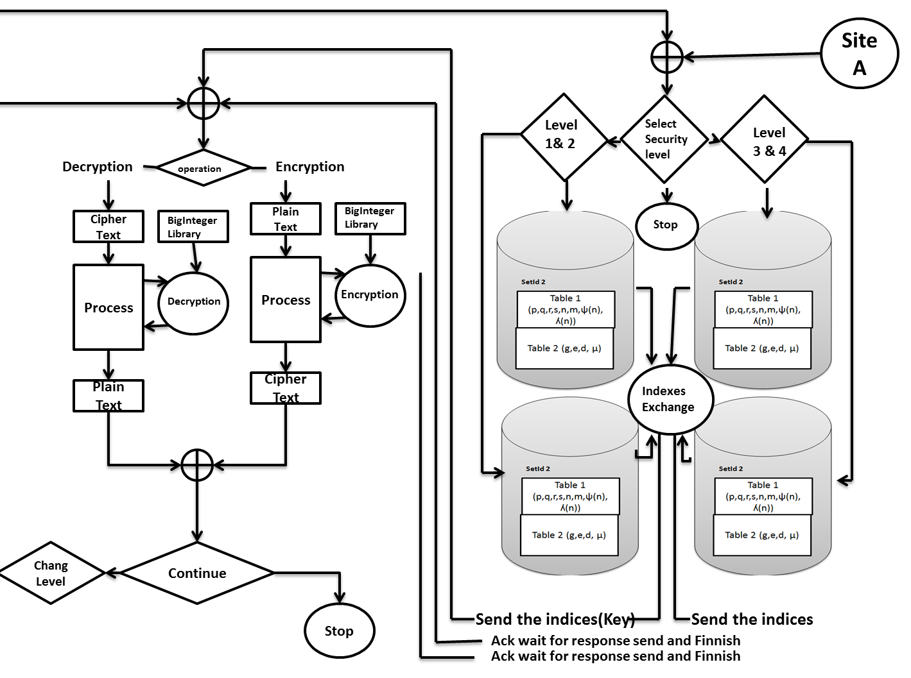
Yes
No
Yes
No
Site B
Response Acknowledgement
Response Acknowledgement
Change the level

Slide 11


System
System
Big Integer library
Big Integer library
Plain text
Cipher
text`
Plain text
User
Encryption
Decryption
Output
Database

